Slide 1

TortoiseGit
Teacher: Omar Ali Zatarain Dúran
Course: Software Configuration Management
Author: Francisco Ismael López Gómez

Slide 2
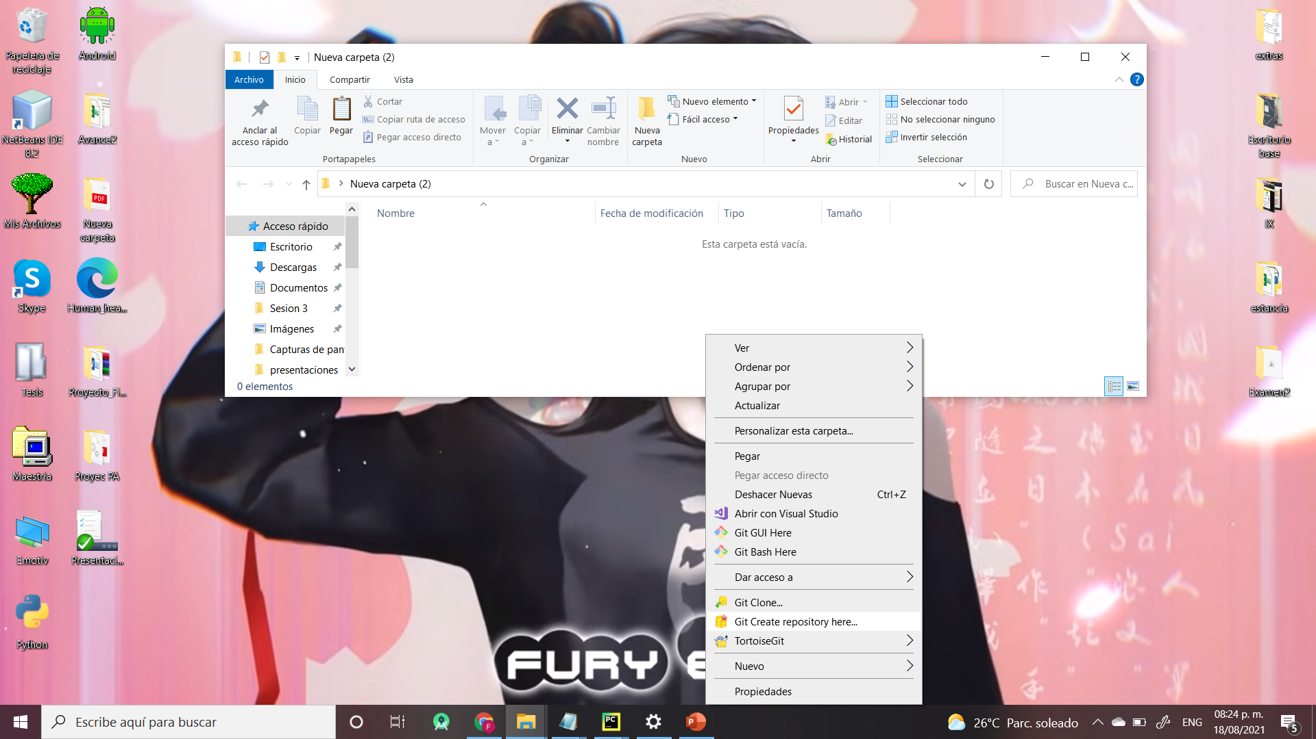
Create Repository

Slide 3
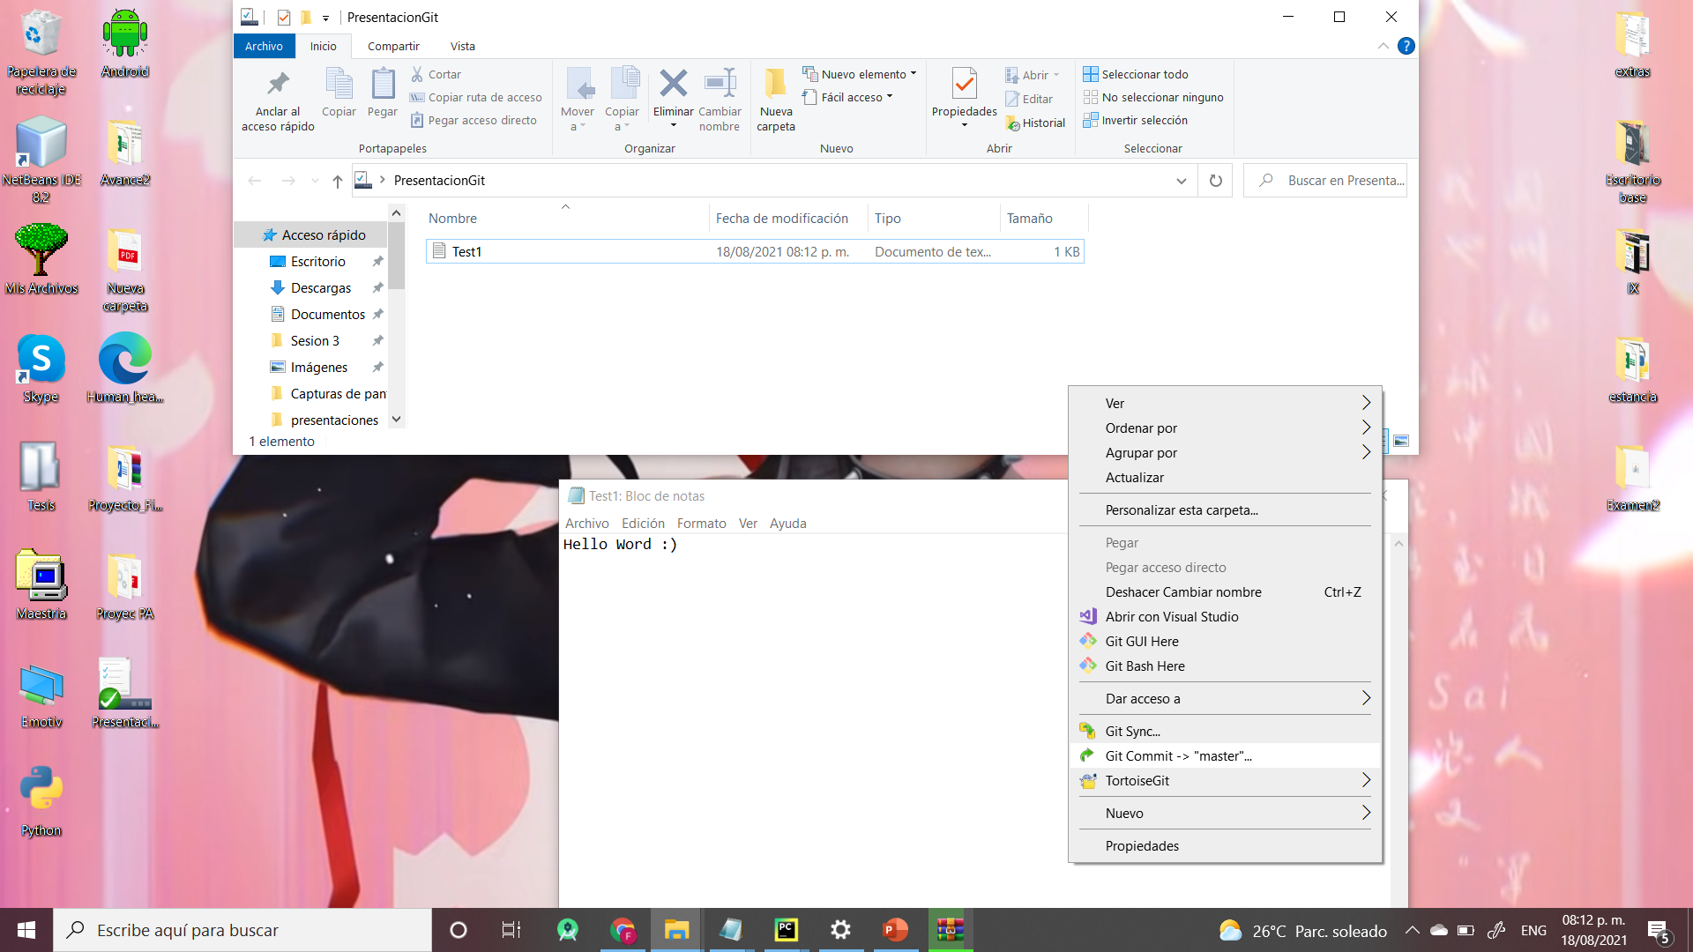
Save modifications

Slide 4
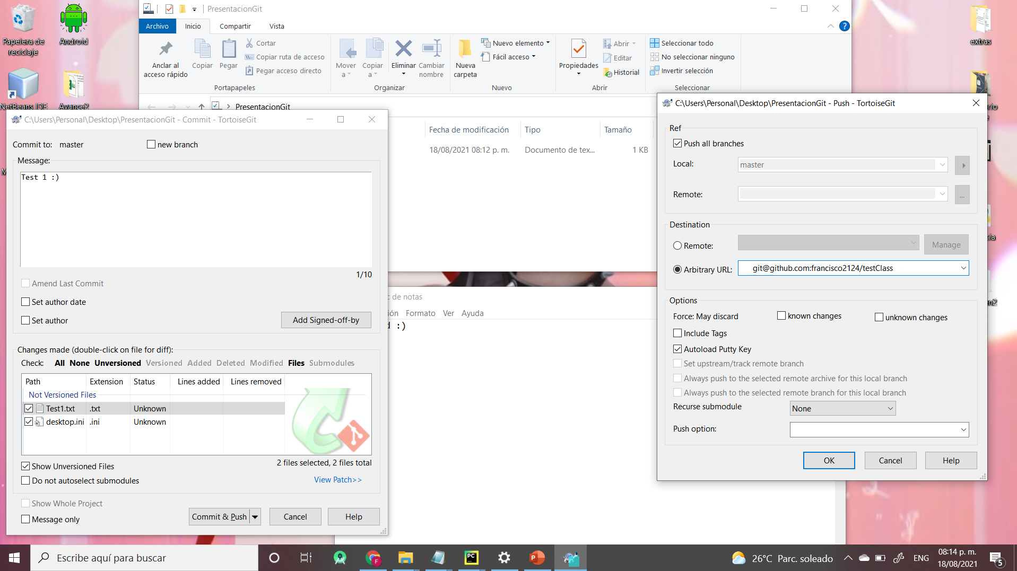
Add link of you repository

Slide 5
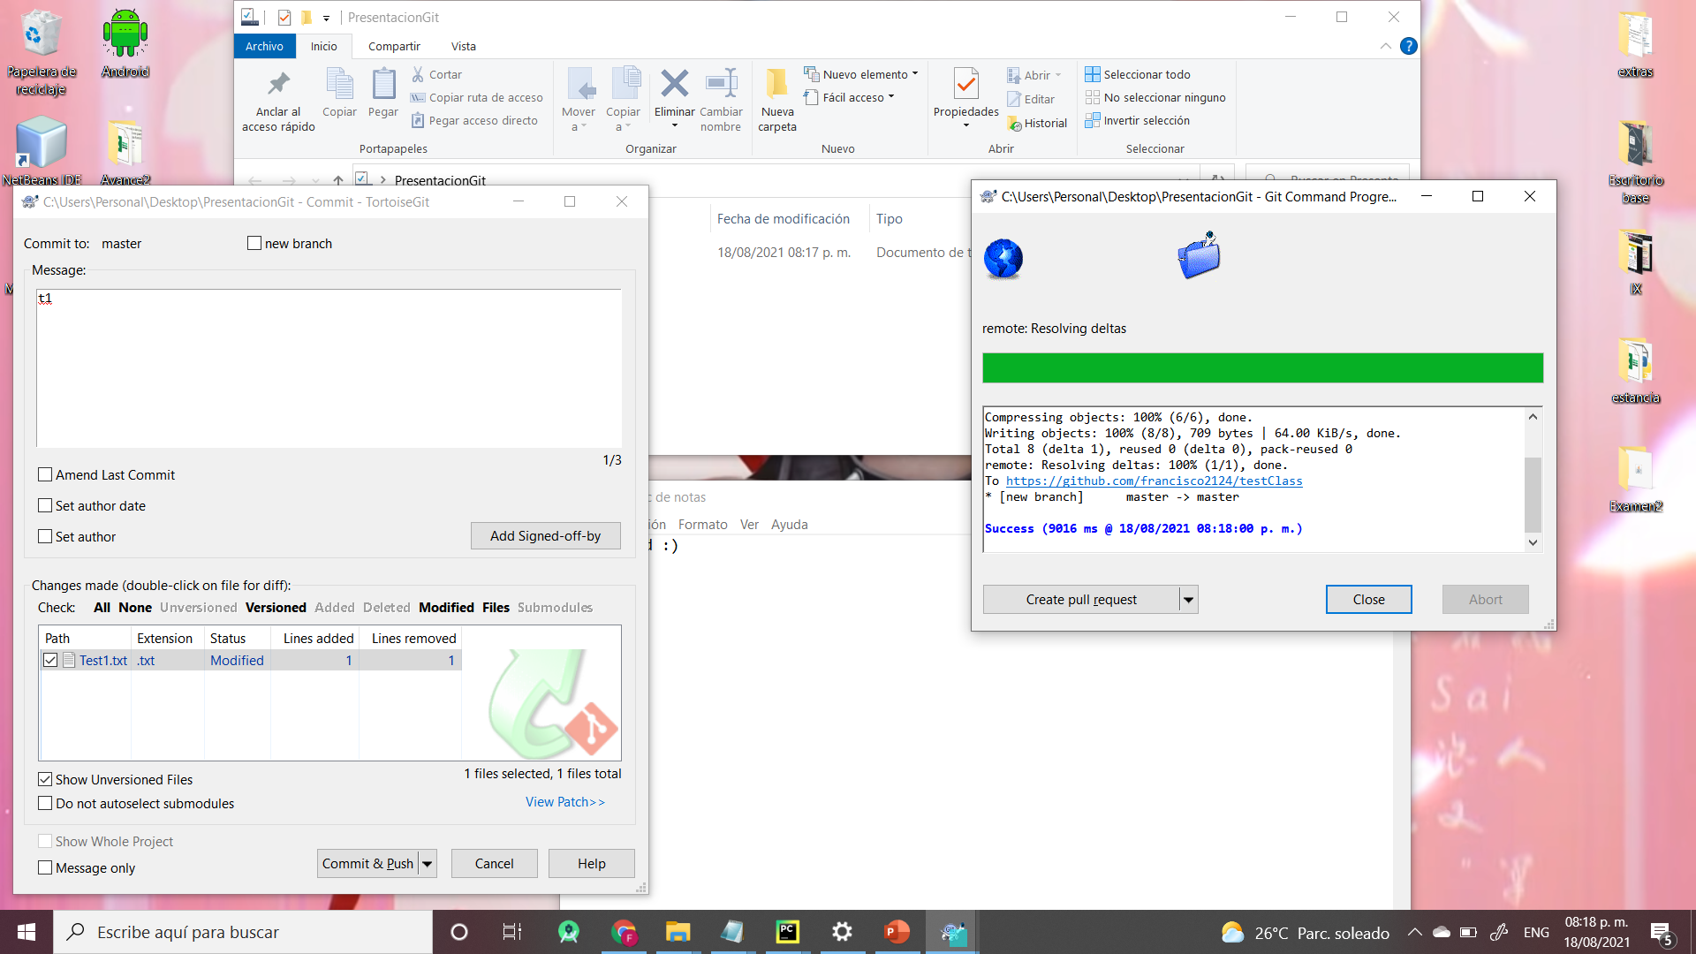
Modifications saved

Slide 6
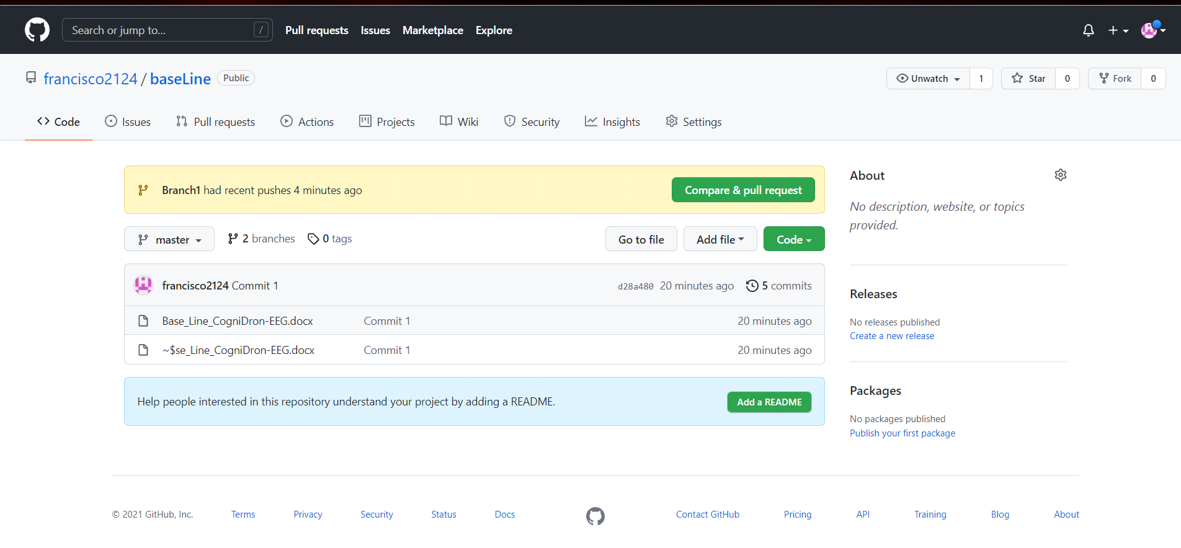
The changes are reflect in the online repository

Slide 7
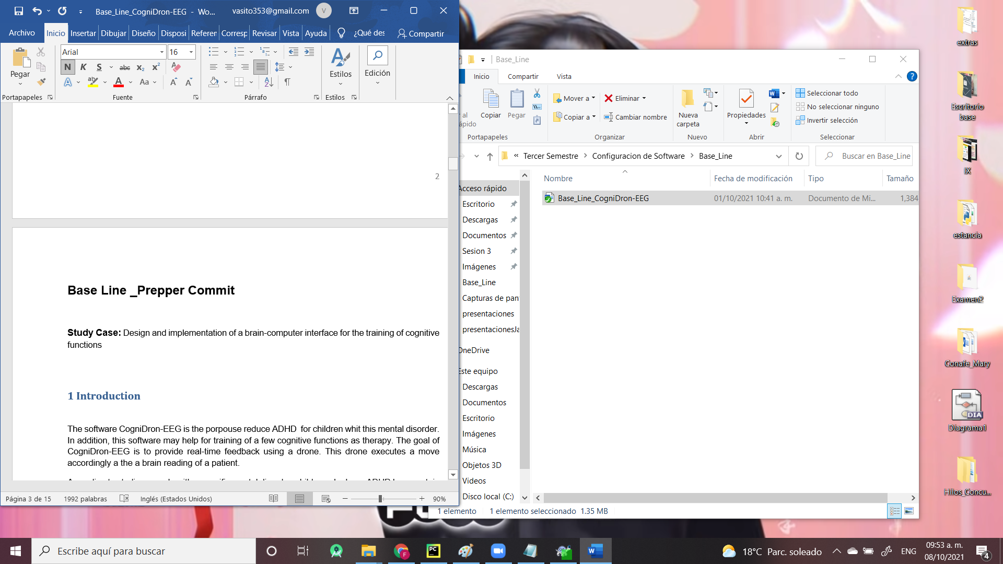
Do a Commit

Slide 8
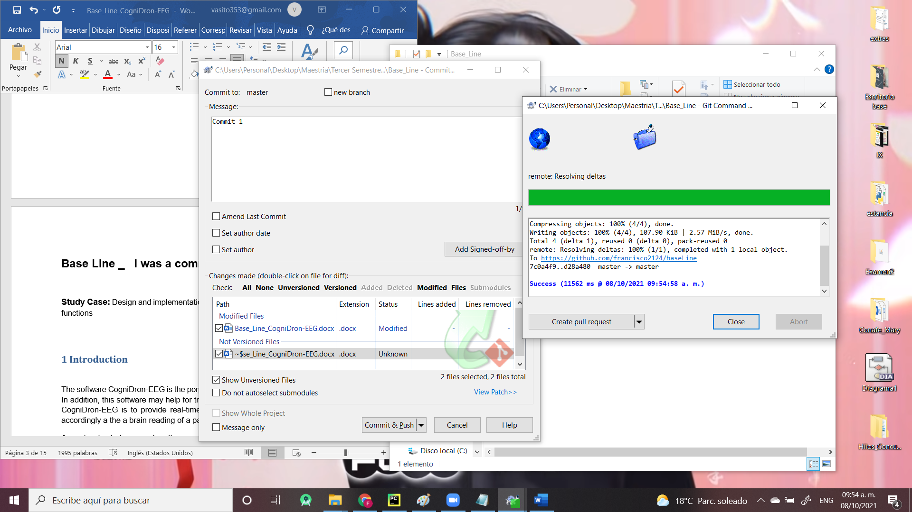
Do a Commit

Slide 9
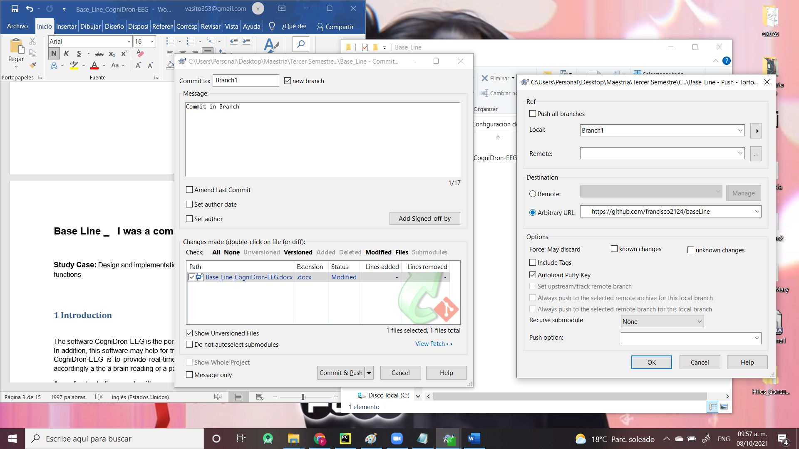
Create Branch

Slide 10
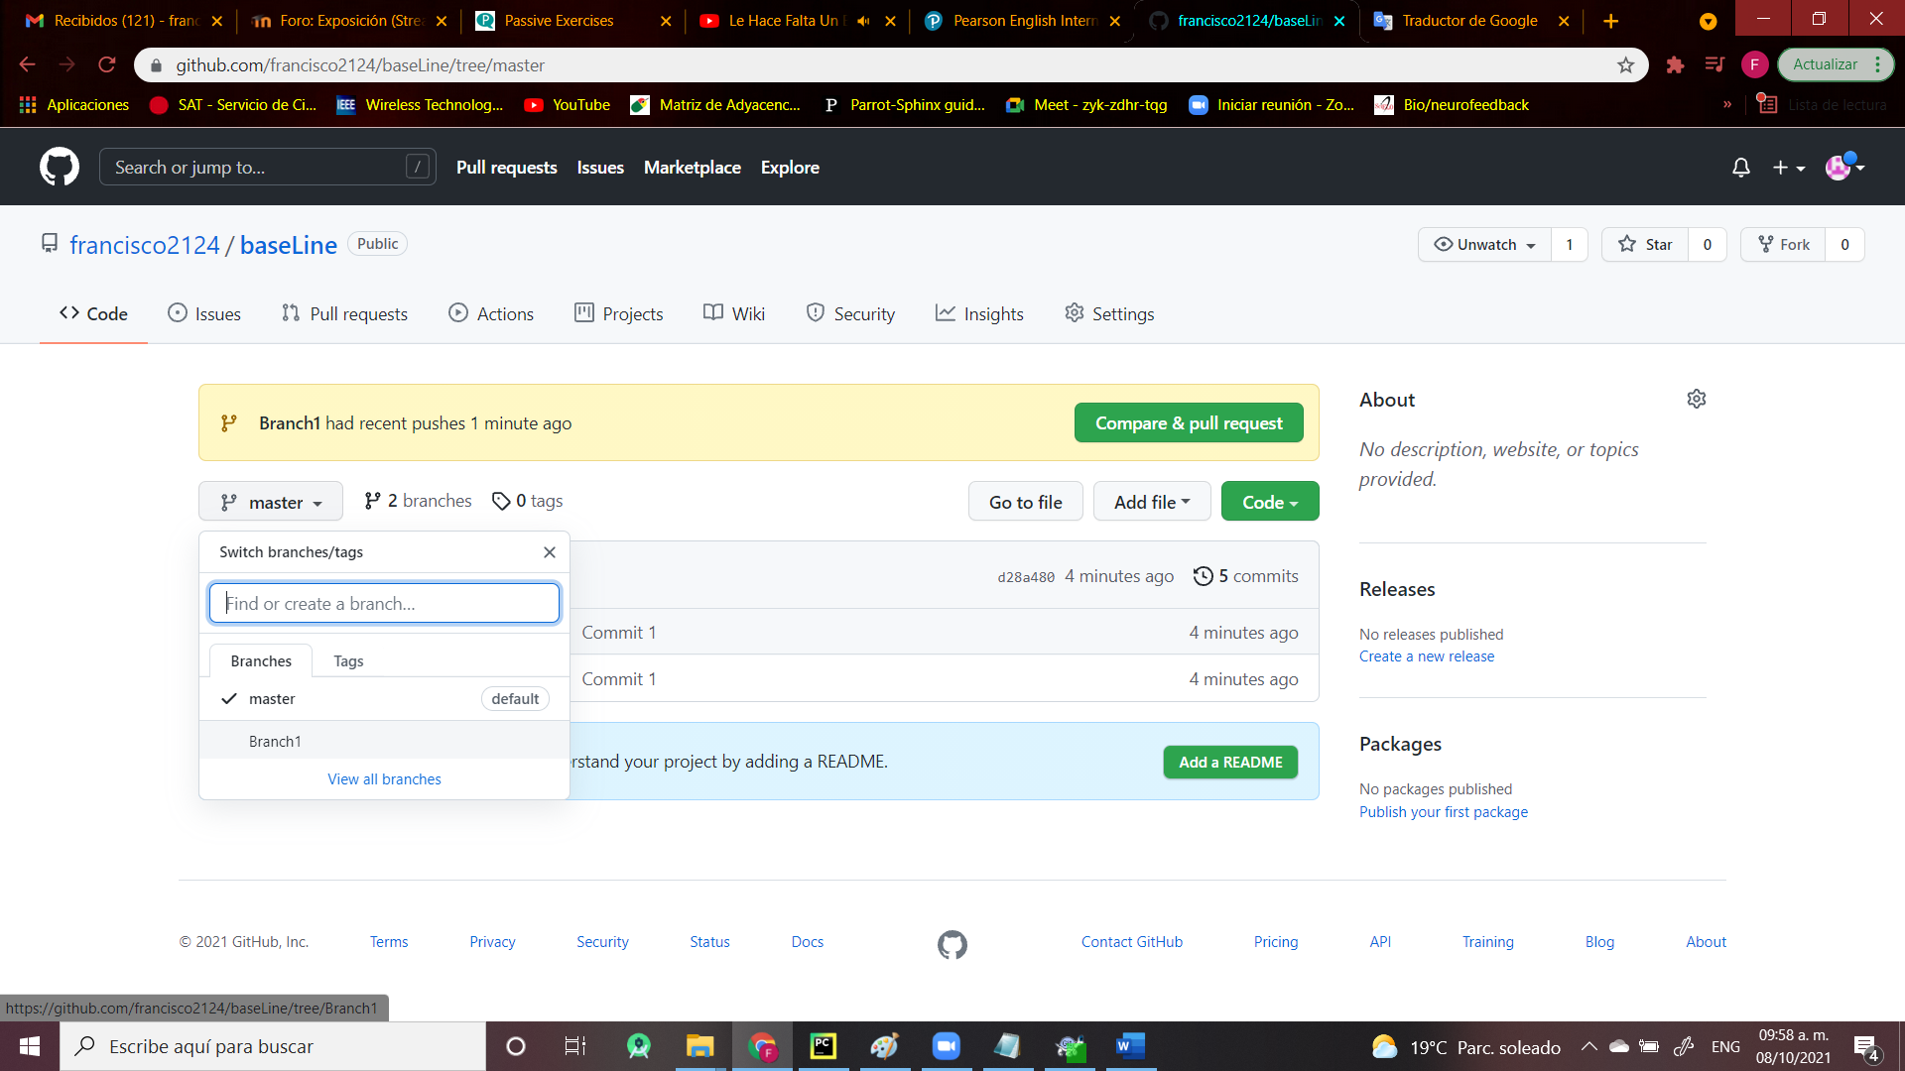
Create Branch

Slide 11
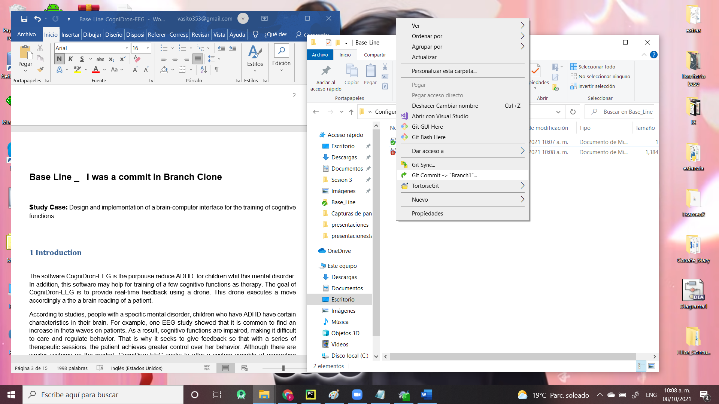
Commit in Branch

Slide 12
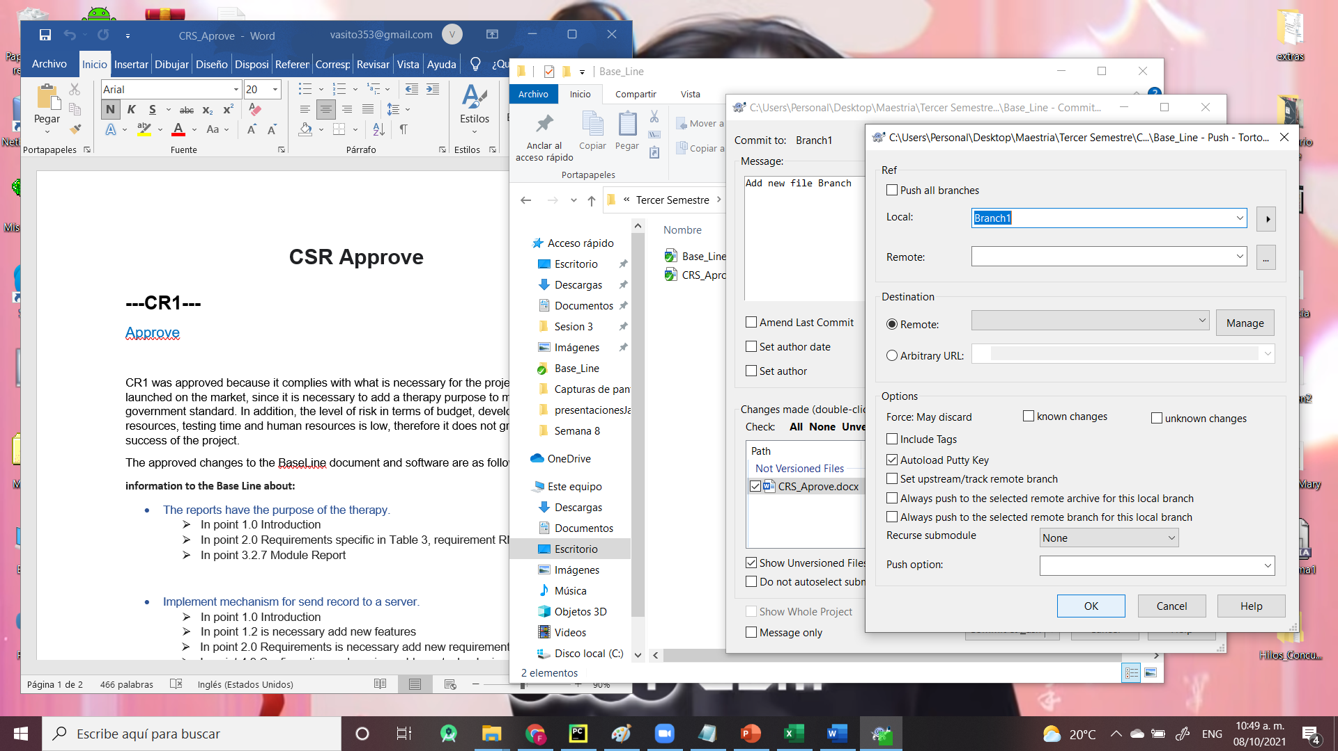
Commit Branch (New Document)

Slide 13
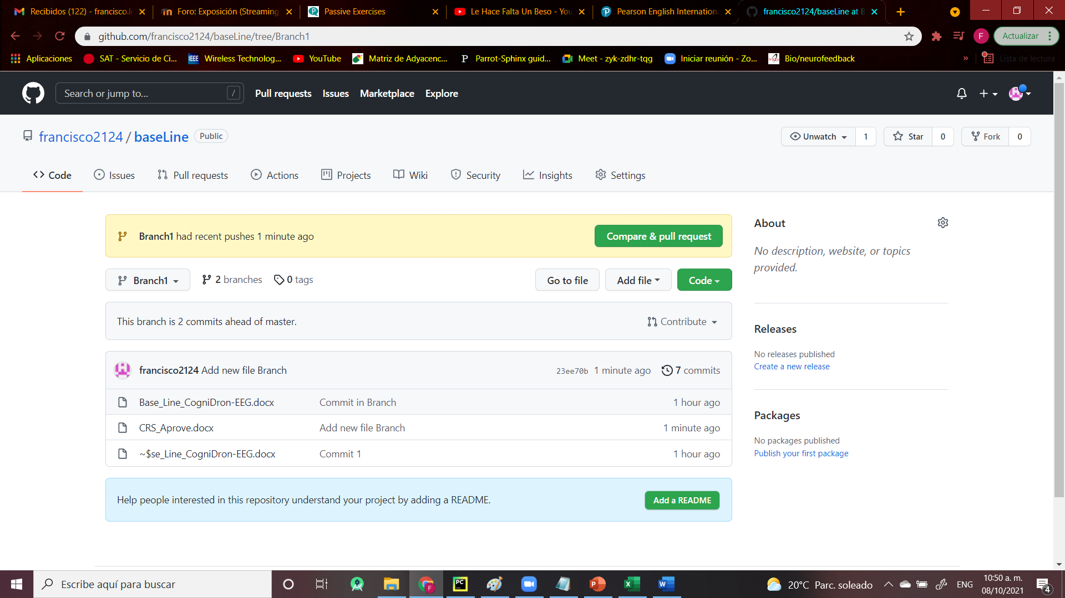
Commit Branch (New Document)

Slide 14
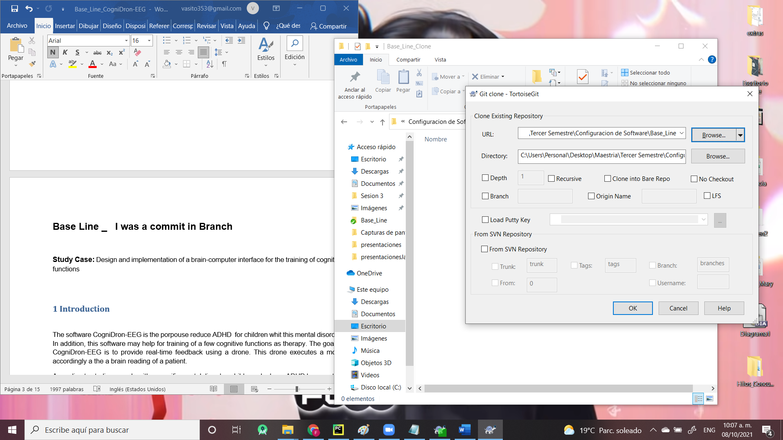
Create Clone Branch

Slide 15
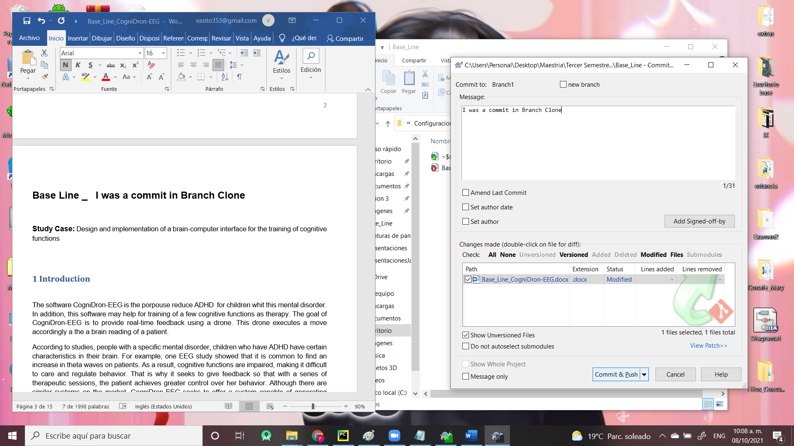
Commit in Clone Branch

Slide 16
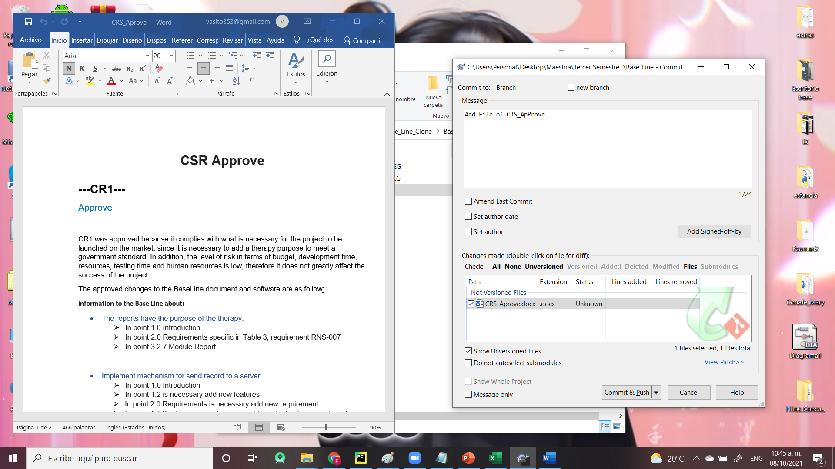
Commit in Clone Branch (New Document)

Slide 17
References

